Slide 1

PROJECT FOR COMPUTER PROGRAMMING 1

Slide 2
Assalamualikum Everyone
Welcome to our presentation of final project.
HALKhata
A personal finance application

Slide 3

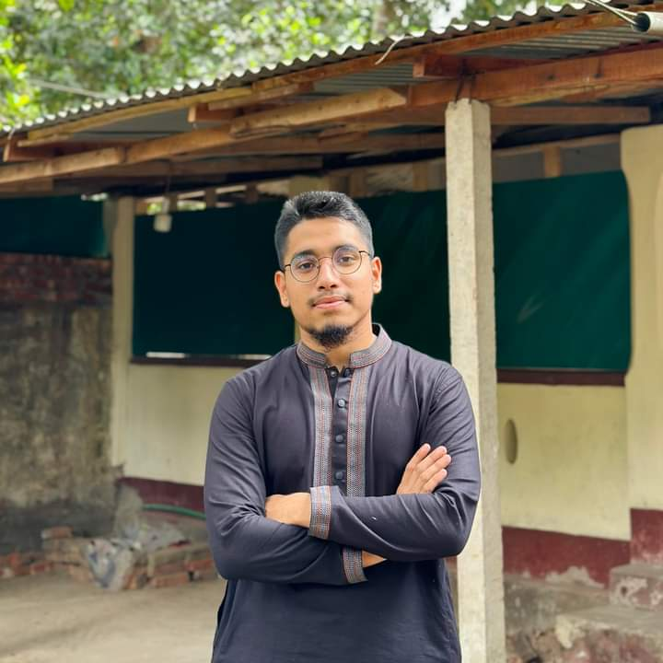


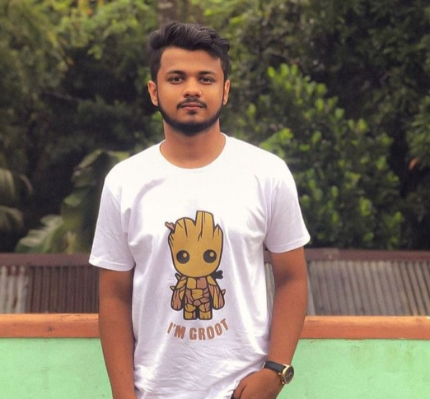
Meet the team
MOHAMMAD IFTIKAR HASAN (ID:C231083)
SHAFKAT ISLAM RAKIN (ID:C231106)
Sayed Shahriar Istiyaq
(ID: C231107)
Nabiul Faisal Tawfik
(ID: C231110)

Slide 4
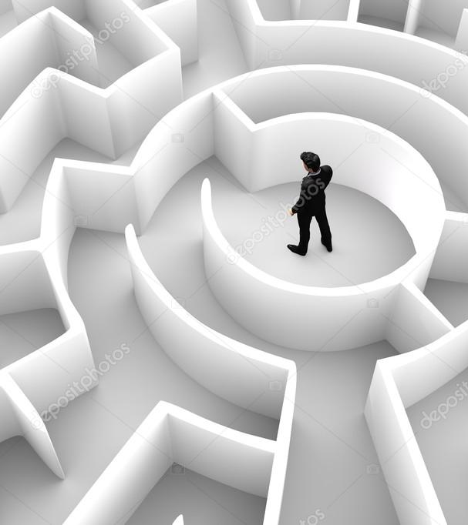
The Problem
Many people struggle with maintaining a clear understanding of their financial situation due to a lack of proper tools and guidance. With numerous expenses to track, from bills and rent to groceries and entertainment, it becomes challenging to keep an accurate record. Without comprehensive insights, individuals often find it difficult to identify areas of excessive spending, save effectively, and plan for their future financial endeavors.

Slide 5
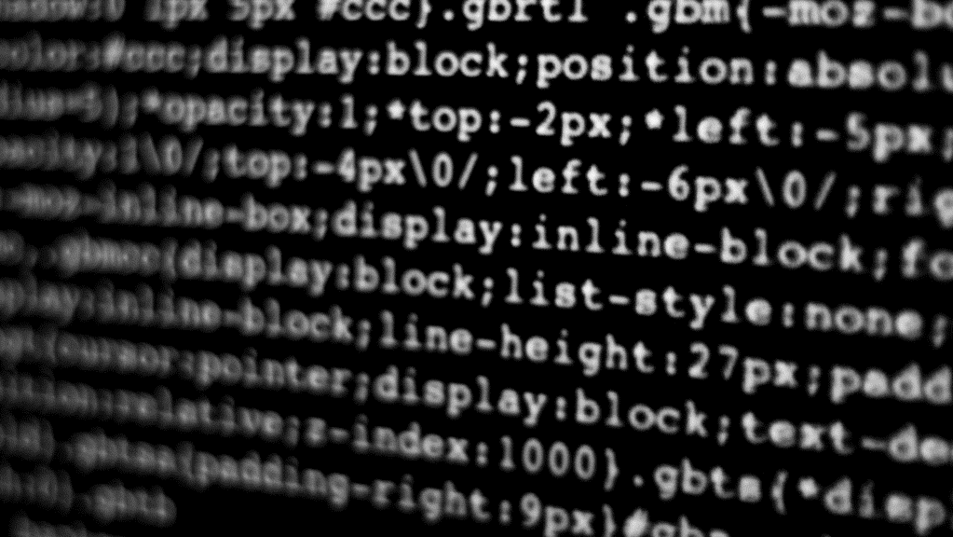
Our solution to the problem:
Halkhata serves as a comprehensive solution to overcome the aforementioned challenges. By offering a user-friendly interface and intuitive features, the app enables users to efficiently track their monthly expenses, helps them to grow financially . Here's how Halkhata helps users achieve financial growth:
Expense Tracking : Halkhata provides a simplified platform to record and categorize expenses. Users can effortlessly log their transactions . This comprehensive overview helps users gain clarity about their spending habits and identify areas where adjustments can be made.
Introducing "My Diary": A convenient feature within Halkhata that helps users effortlessly keep track of their daily tasks and important notes. Stay organized and boost productivity with this powerful note-keeping tool.
Multiple accounts : Our app supports multiple user. With this features all members of a family will able to use Halkhata to track their expenses.

Slide 6
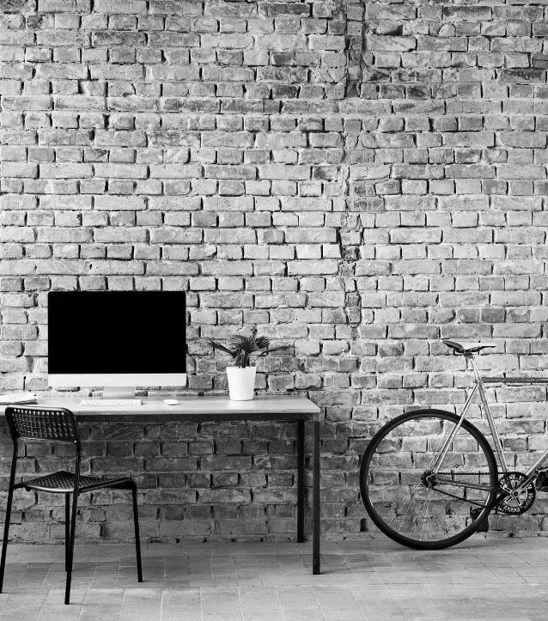
OUR FEATURES:

Slide 7
SIGN UP AND LOGIN

Slide 8
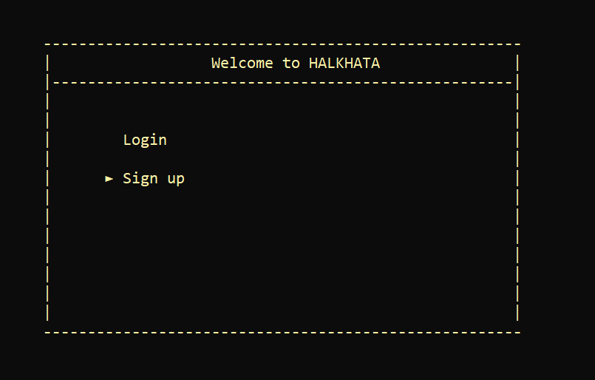

Slide 9
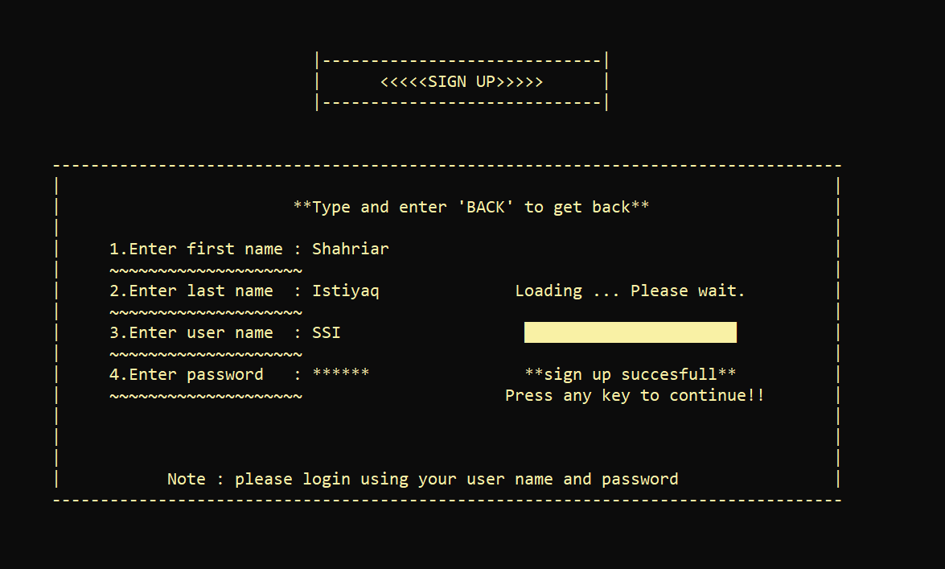

Slide 10
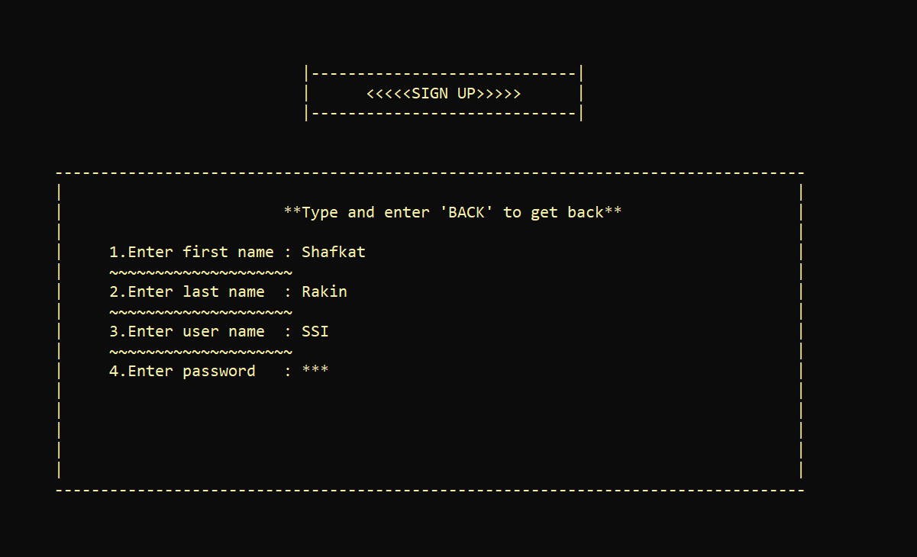
Opening multiple account :

Slide 11
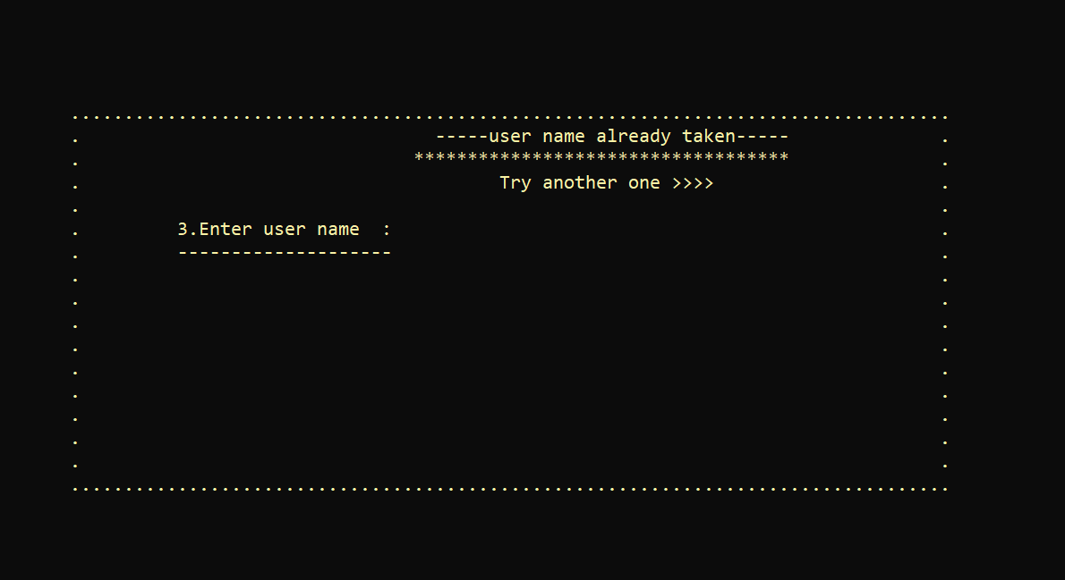
When a new user will signup they have to use unique user name to open an account:

Slide 12
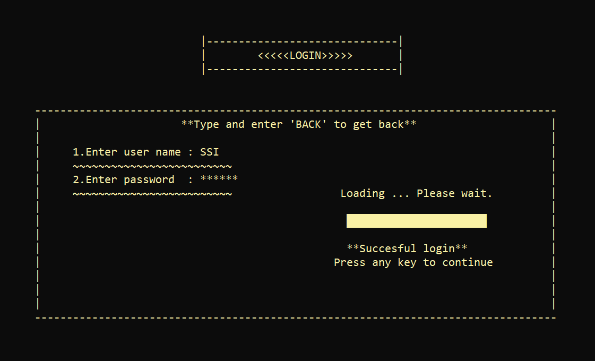
Loging in:

Slide 13
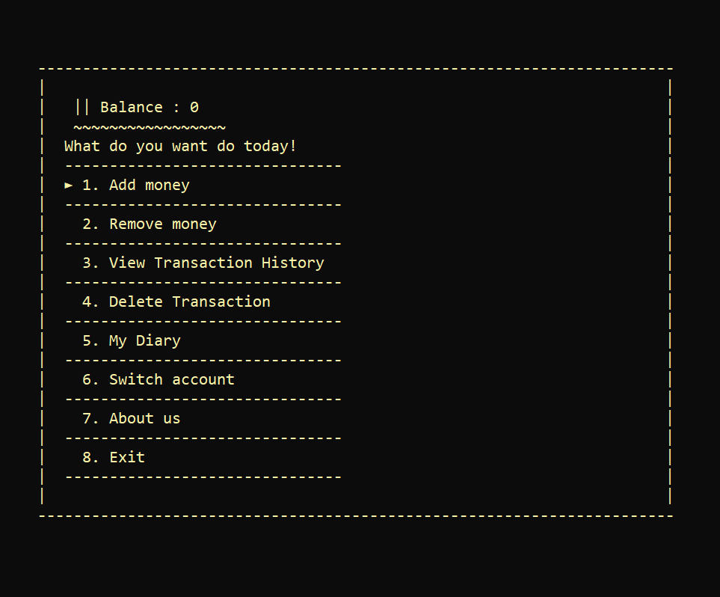
The landing page:

Slide 14
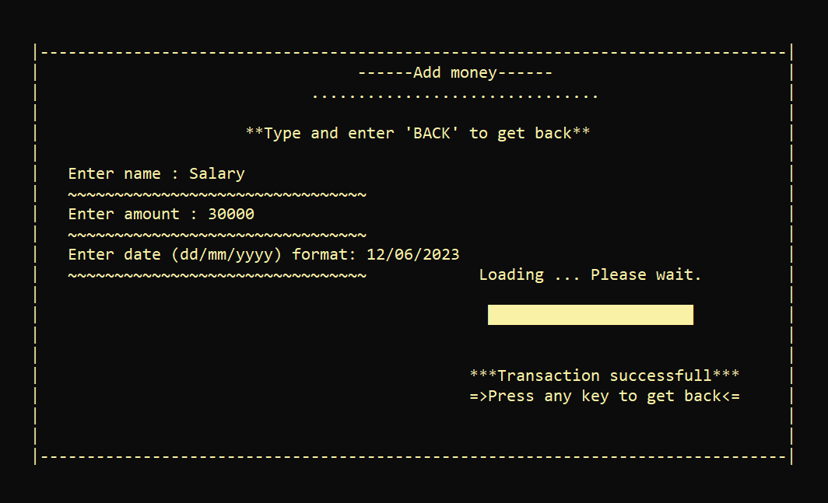
Money adding process :

Slide 15
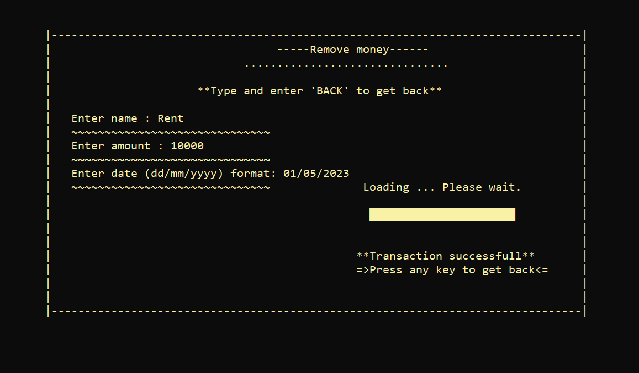
Money removing process :

Slide 16
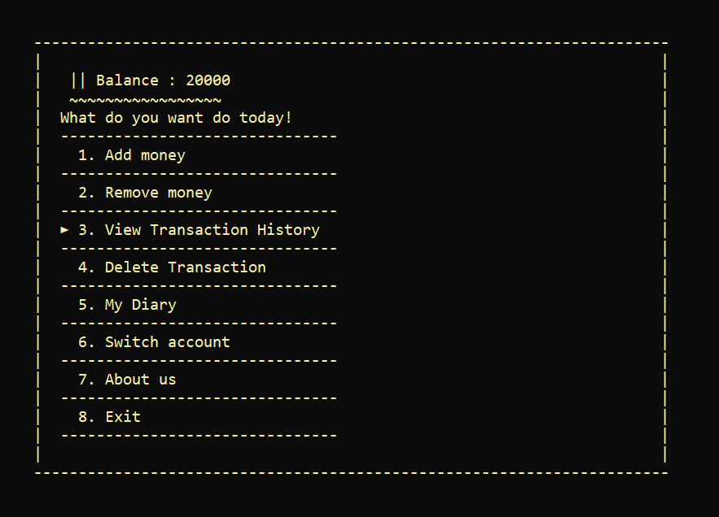
Main balance :
The balance options shows the existing balance of the account after all transactions .

Slide 17
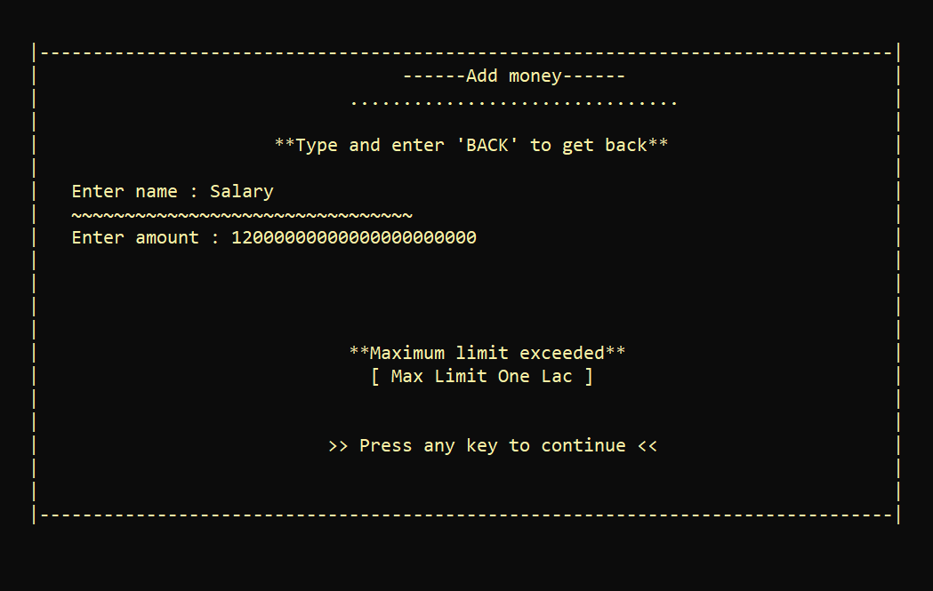
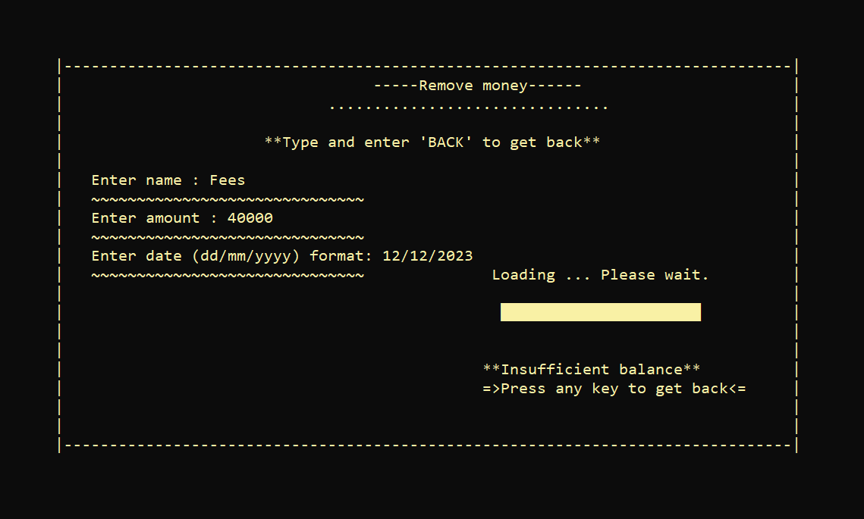
Some additional features:
The maximum limit of a adding transaction is ONE LAC :
User cannot remove greater amount than existing main balance :

Slide 18
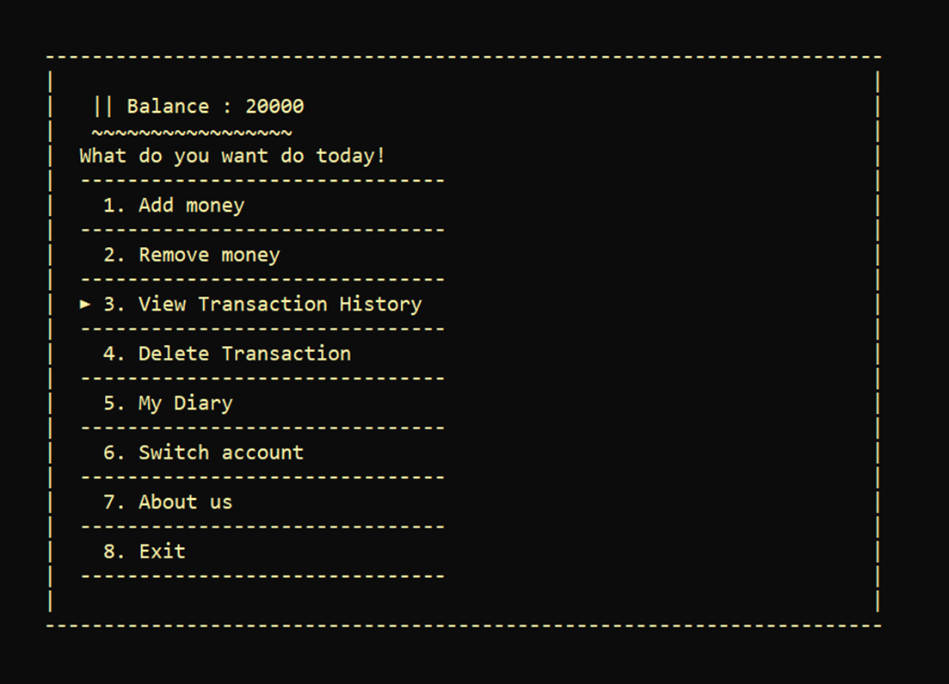
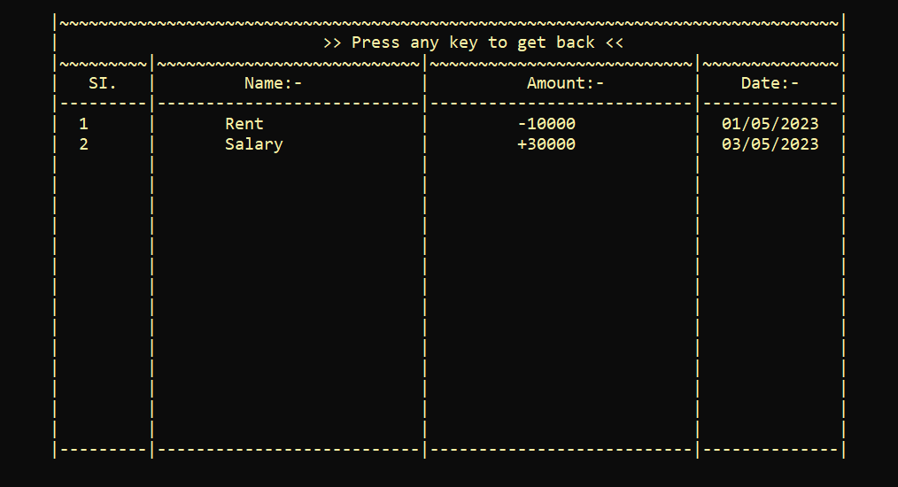
The transaction history feature enables users to effortlessly track and analyze their spending patterns by providing a sorted, date-wise overview of their financial activities. This valuable tool promotes sophisticated money management and enhances users' understanding of their financial decisions.

Slide 19
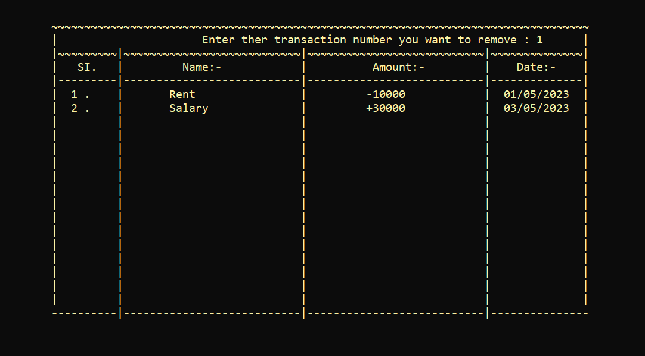
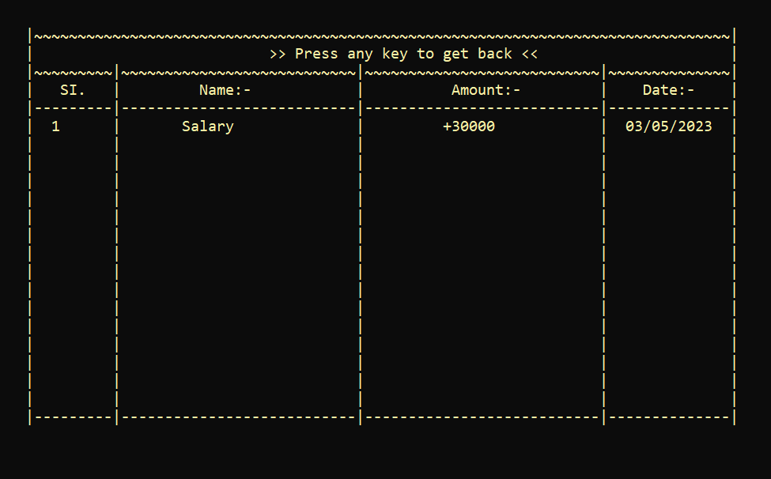
The user can remove any transaction from the existing data just by selecting the transaction number :

Slide 20
MY DAIRY

Slide 21
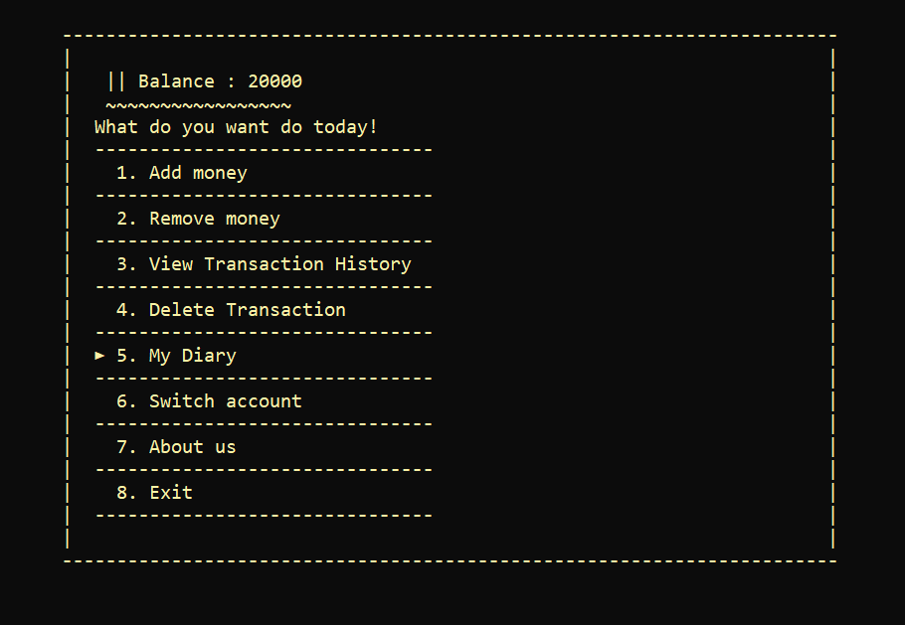
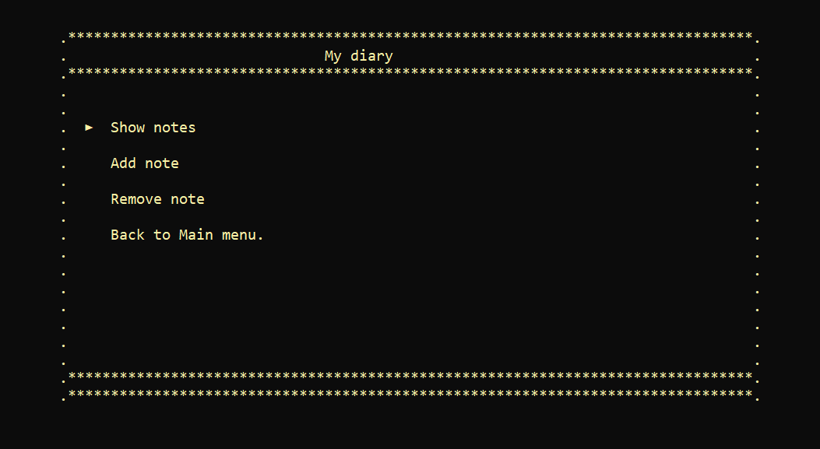
This feature helps users effortlessly keep track of their daily tasks and important notes.

Slide 22
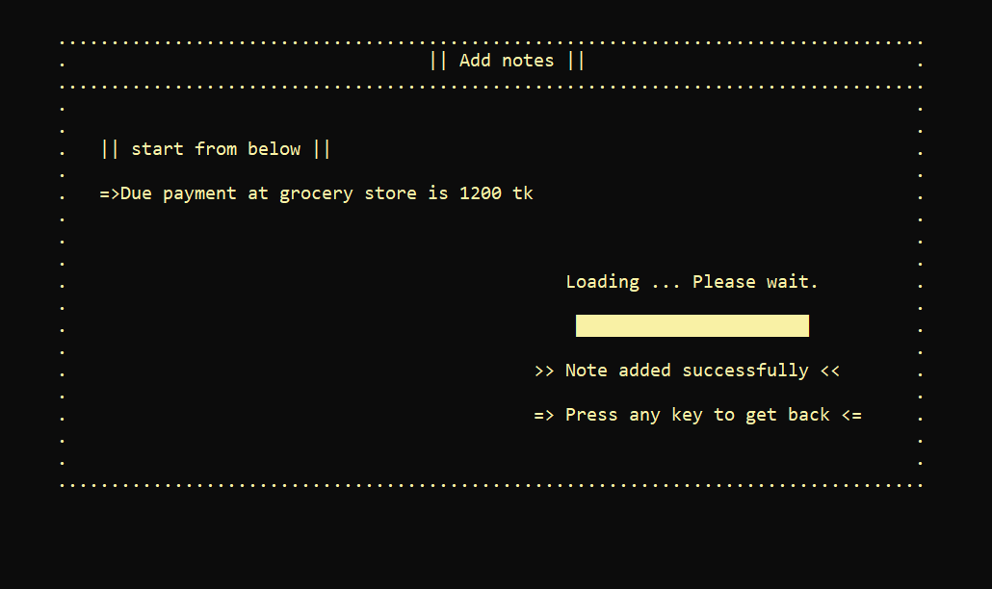
Adding notes :

Slide 23
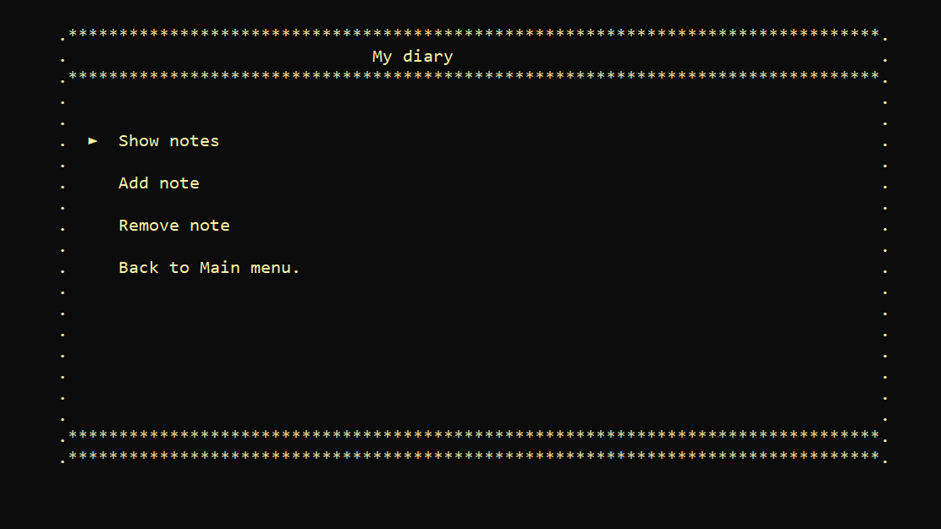
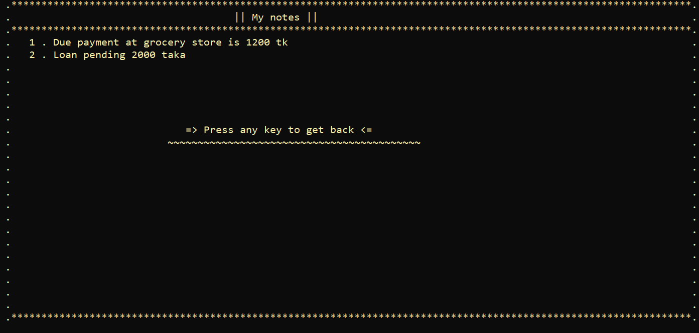
Show notes :

Slide 24
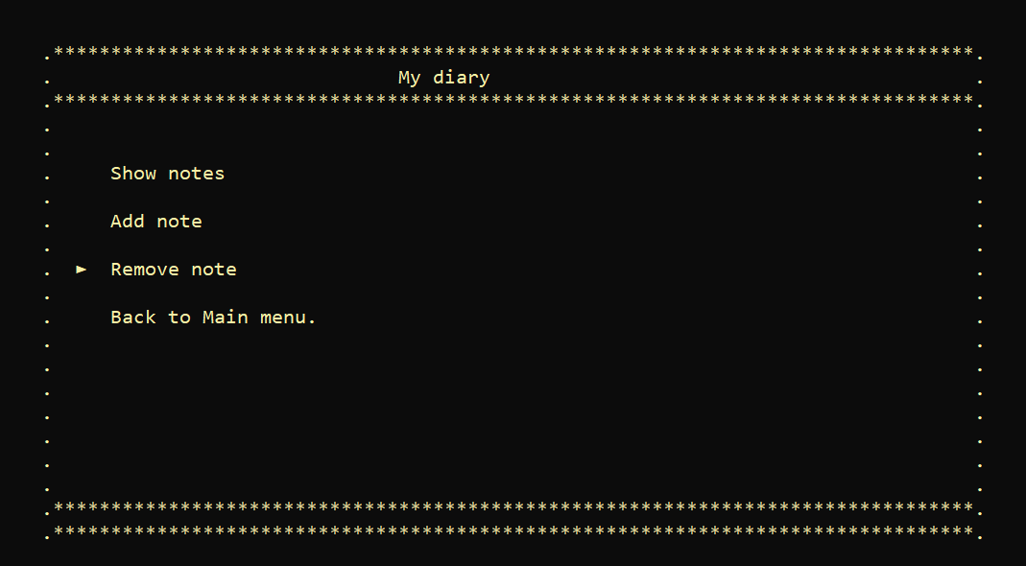
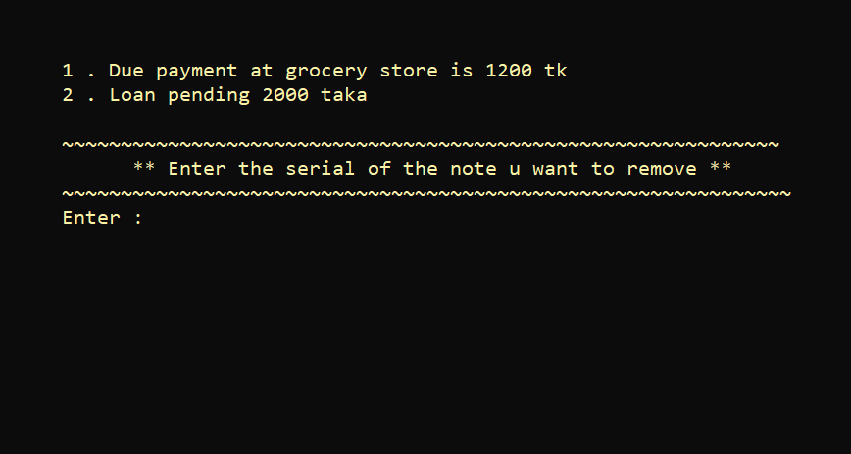
The user can remove any existing note by entering the serial number of a note :

Slide 25
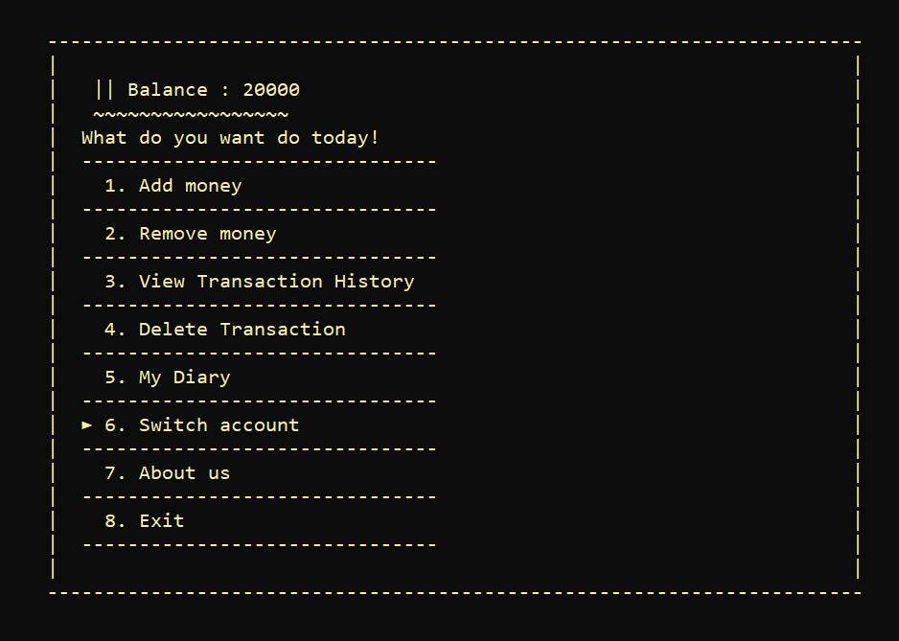
If a user want to switch account in runtime they can do it by clicking on “Switch account” option. This will take the user to the login page from where they can log into new account:

Slide 26

The "About Us" option includes a brief introduction of the developers :

Slide 27
THANK YOU, everyone for your time and hope you enjoyed our presentation

